Slide 1

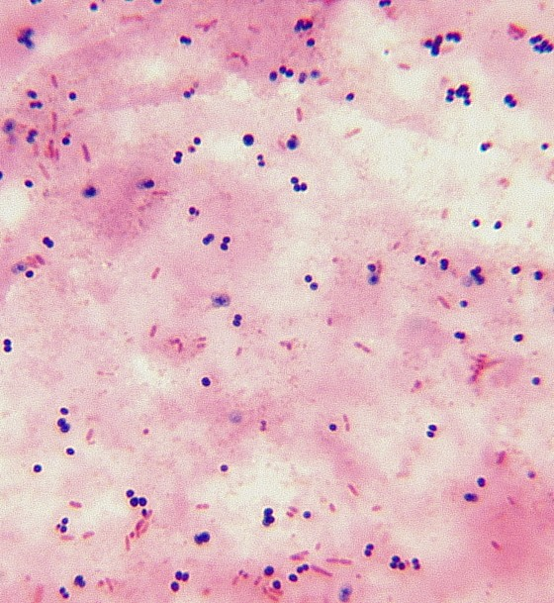
Pasteurella
Pasteurella & mannheimia are members of the family Pasteurellaceae that contain small, facultatively anaerobic, non-motile, G- rods or coccobacilli that do not form spores. Glucose is fermented without production of gas. The oxidase is +, the nitrate is reducd to nitrite. These organisms are found as mucosal commensals of the oropharynx &GIT of healthy mammals, birds & reptiles.
Genus Pasteurella:
The genus pasteurella contains veterinary pathogens that are small, non-motile, G- coccobacillary to rod-shapped bipolar staining appear single or pairs. They are nutritionally fastidious& required blood or serum for growth., which is enhanced by increase CO2 concentration.

Slide 2

Diseases
& Epidemiology
P.multocida is among the most fascinating bacterial pathogen particularly in its wide host range. It is associated with a wide range of major diseases in animals, such as hemorrhagic septicemia in cattle (often as secondary invaders). Fowel cholera, atrophic rhinitis & rabbit pasterurellosis. The organism is zoonotic, & human infection are derived largely from animal bits. In developing countries pasterurellosis remains a widespread problem with serious economic consequences.
Many P.multocida strains express a polysaccharide capsule, 5 serogroups (A,B,D,E and F) are distinguished by direct hemagglutination of capsular antigen. Type A strain cause fowel cholera, rabbit snuffles & bovine pneumonia. Hemorrhagic septicemia strains belong to serogroup B & E, & swine atrophic rhinitis strain to serogroup D. Type F strains have been recovered mainly from turkeys.
By gel precipitation of O (somatic) Ag at least 16 types are deigned.

Slide 3
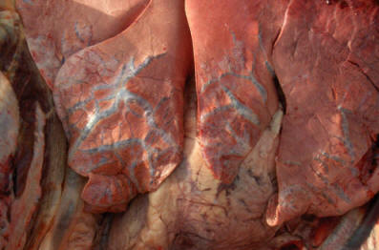
Hemorrhagic septicemia
Hemorrhagic septicemia is an acute, highly fatal disease of cattle, water buffaloes caused by P.multocida serotypes B2 & E2. Buffaloes appear to be the most susceptible animals, and cases occur sporadically in goats. sheep, camels. The disease causes significant economic losses in tropical & subtropical regions of Asia & Africa. Disease outbreaks are usually preceded by drastic changes in weather, poor nutrition & overcroeding. Morbidity & mortality rates vary from 50% to 100%. 50% of healthy animals in herds that experienced disease harbor the organism on their tonsils or nasopharyngeal mucosa as compared ton 3-5% in disease free- herds.
Spread occurs directly or indirectly to susceptible animals from contact with saliva or nasal discharge from carrier or clinically ill animals.
The disease is characterized by acute septicemia, high fever, profuse salivation, dyspnea, subcutaneous petechiation & occasionally dysentery. Death occur within 24 hrs.

Slide 4
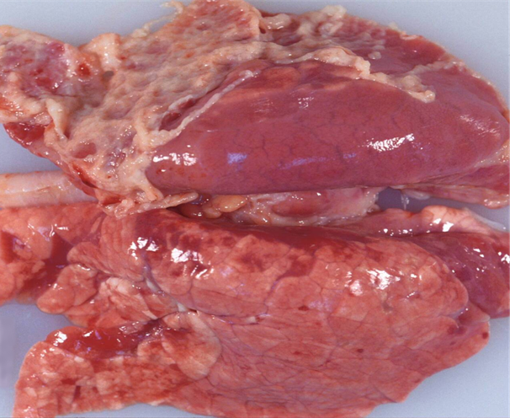
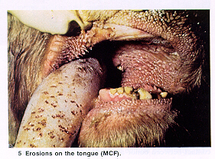

Slide 5
Bovine & porcine pneumonia
P.Multocid serogroup A3 is isolated frequently from beef cattle with fibrinous broncho- & pleuropneumonia as part of bovine respiratory disease complex. The disease affect most frequently the recently weaned animals. The organism is regarded as opportunistic pathogen with low virulence that usually invade as secondary to viral or bacterial pneumonia.

Slide 6
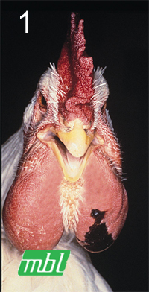
Fowel cholera
Fowl cholera is highly contagious & affects a wide range of domestic & wild birds in most countries. It is usually manifests as septicemia with high morbidity & mortality (upto 70%), but may also occurs in a chronic form. Fowl cholera is most prevalent in summer & winter. Turkeys, domestic ducks & geese are more susceptible to disease than chicken. The disease often result in reduced egg production & localized infections.
Chronically infected birds are major reservoirs of infection. Excretions from infected birds may spread the disease within the flock, either directly or indirectly. Signs of acute disease in turkey are usually apparent for only few hours before death & include fever, diarrhea, mucoid oral discharge.
Chronic fowl cholera may result from infection with a strain of low virulence or may be as sequel to the acute disease. Localized infections are the hallmark of this form. Swollen wattles, joints or footpad & conjunctivitis, torticollis, rales or dyspnea may be present.

Slide 7
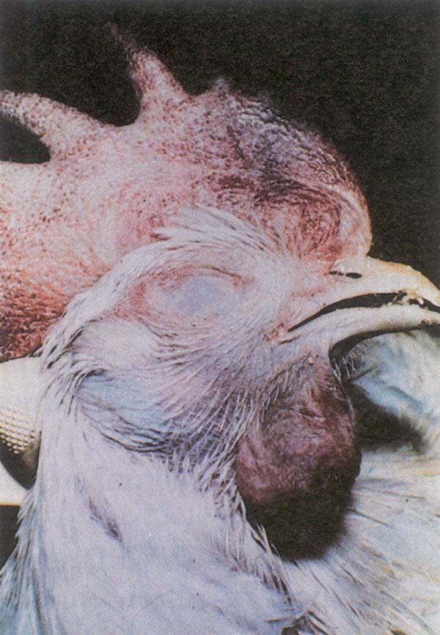
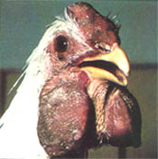

Slide 8
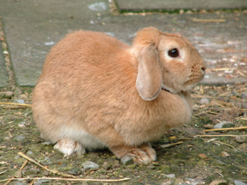
Rabbit pasteurellosis
Pasteurellosis often called snuffles is the most important bacterial disease of rabbits & is the most often caused by P. multocida. 50% of raised rabbits may have upper respiratory colonization by P. multocida & may are asymptomatic. Neonates become colonized during parturition. Envirnmental factors such as temperatue fluctuation, increased ammonia levels, poor sanitation, gestation & old age may initiate clinical disease.
Pasteurellois in rabbits also manifests as otitis media or interna, pneumonia, abscesses, conjunctivitis, mastitis, metritis, & septicemia. Signs exhibited depend on the site of infection & may include oculonasal discharge, sunffling, dyspnea, cynosis, torticollis, vaginal discharge subcutaneous swelling & sudden death.

Slide 9
Other pasteurella species
P. trehalosi is a cause of septicemia & pneumonia in feeder lambs. The disease is characterized by a sudden onset of fever, anorexia, respiratory distress & sudden death. All breeds & sexes are equally affected. Recently weaned or transported lams have the highest incidence of disease. Most outbreaks occur from late summer. Infection by viruses or other bacteria increases susceptibility of lams to infection with P. tehalosi. Transmission is by direct or indirect contact.

Slide 10
Pathogenesis
P. Multocida strains associated with fowl cholera usually enter avian tissues through the mucous membrane of the pharynx, URT, conjunctiva. In atropic rhinitis toxigenic P. multocida strains of serogroup D attach to the membranes overlying nasal turbinates, organism multiply & produce dermonecrotic toxins that destroys osteoblasts & causes osteoclastic lysis resulting in turbinate destruction.
Virulence factors of pasteurella spp. Include capsule, endotoxin, exotoxin, adhesins, hemagglutinins, & proteases. Strain with hyaluronic acid capsule are more resistant to phagocytosis & intracellular killing. Endotoxin or lipopolysaccharide is pyrogenic. Strains of serogroup A,B & D have type 4 fimbriae with adhesion to host epithelial cells.
P. multocida expresses a siderophore called multocidin which scavenges iron from host iron-binding glycoproteins.
P. trehalosi produce collagenase which may destroy collagen in the lung paranchyma allowing deeper penetration f the bacteria & further inflammation.

Slide 11
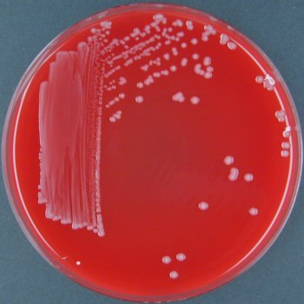
Laboratory diagnosis
Isolation of the causative organism from the affected tissue. The routine isolation medium is blood agar although pasteurella V-factor dependent grow well on chocolate agar incubates at 5% CO2 at 37 C for 24-48 hrs.
Colonial morphology, Gram stain & biochemical reactions including oxidase, catalase, nitrate reduction, urease, hemolysin & indol production.
Sugar fermentation to differentiate pasteurella spp.
Serological tests for diagnosis of fowl cholera ( agglutination & agar gel diffusion precipitation tests) have limited value in the chronic disease & no value in acute form of the disease.

